Slide 1

AI Collaborative Art: Real Time Mutli Style Transfer
Masters in Artificial Intelligence and Robotics
AI Project
SoSe 2025
Prof. Dr. Jonas Kemnitzer
By
Sanjay Sampathkumar | Rajalakshmi Sribalakrishnan

Slide 2
Table of Contents
Title | Slide No
Introduction | 3
Project Goal | 4
Requirement Analysis | 5
System Architecture | 6
Model Significance | 7
Implementation | 8
Testing and Evaluation | 9
Visual Results | 10
User Interface | 11
Limitations and next steps | 13
Conclusion | 14
References | 15

Slide 3
Introduction
Many people struggle with manual drawing-to-digital transitions.
Existing AI style transfer didn’t preserve user brush strokes well.
We combined a lightweight LoRA style transfer model.
We wanted it to run in real time on the web — so it’s easy for anyone to use.
Notes:
Many users find it challenging to convert their hand drawn sketches into digital art, especially while preserving their brush strokes.
Existing AI style transfer models often fail to retain the original structure of user input.
Our solution combines a lightweight LóRA style transfer model with stable diffusion, optimized for real time use on the web.

Slide 4
Project Goal
To build a web-based platform where users can draw or upload an image and apply different artistic styles in real-time.
Key Features:
Users can draw or upload images directly on the web app.
Styles include oil painting, crayon, pencil sketch, etc.
Uses LoRA fine-tuned Stable Diffusion models for style transfer.
Generates 3D mesh representations from stylized images.(additional)
Notes:
The main goal is to build a web platform where users can either draw or upload images and instantly apply various artistic styles.
The key features
Drawing/uploading images directly in the user interface/browser.
Multiple styles include oil painting, crayon, pencil sketch, watercolor and mosaic
LoRa fine tuned stable diffusion models for fast, flexible style transfer.

Slide 5
Requirement Analysis
Frontend: HTML, JavaScript, Canvas API for freehand drawing.
Backend: Flask server, Python, Torch, PEFT for LoRA adapters.
AI Models: Stable Diffusion Img2Img pipeline — because it keeps the user’s sketch structure.
LoRA adapters — lightweight training for multiple styles.
Hunyuan3D for basic shape generation.
Hosted on JupyterHub with GPU (24GB) + ngrok for tunneling.
Everything tied together using REST APIs.
Notes:
The frontend is built with HTML, Javascript and canvas API for drawing.
The backend uses flask(python), torch and PEFT for LoRA adapters
The AI models chosen are
Stable diffusion img2img- Chosen for its ability to preserve sketch structure
LoRA adapters- Allows multiple styles with lightweight training and tuning.
Hunyuan 3d- Generates basic 3d shapes from images.
The deployment is hosted on Jupyterhub with GPU acceleration and ngrok for web access.

Slide 6
System Architecture
User draws → canvas saves image in base64.
When the user clicks Stylize, we send it to the remote server’s /stylize endpoint.
Server loads the LoRA weights, applies style, returns an image.
Additionally, if the user clicks Convert to 3D, the same image goes to /convert → Hunyuan3D generates a .glb file.
User can view or download the 3D file.
Notes:
The workflow is as follows
The user draws on the canvas, the image is saved in base64 format.
Clicking stylize sends the image to the servers/stylize end point
Server loads the appropriate LoRA weights, applies the style and returns the stylized image.
For 3d conversion, the image is sent to /convert, where Hunyuan 3d generates a gib 3d file.
Users can view or download the 3d model.

Slide 7
Model Significance
LoRA: Small adapter layers → easy to switch styles without re-training everything.
It works well for style transfer when you have a limited dataset.
Stable Diffusion Img2Img: Better than text-to-image for sketches → keeps the structure.
We tested Johnson et al. style transfer, but it didn’t preserve lines as cleanly.
Hunyuan3D:Fast for basic 2D-to-3D — enough for a proof-of-concept.
Notes:
LoRa- enables quick switching between styles without retraining the entire model. Especially effective with limited data per styles.
Stable diffusion- Superior at preserving the structure of sketches compared to other methods like Johnson et al
Hunyuan 3d- Offers fast, basic 2d to 3d conversion, sufficient for demonstration purposes.

Slide 8
Implementation
Used 10 images per style, manually curated.
Preprocessed to consistent 512×512 resolution.
LoRA hyperparameters: r=4, alpha=16, small dropout.
Used the PEFT library to insert adapters correctly.
Faced common issues: missing target modules, OOM errors, adapter stacking.
Solved by inspecting UNet layers and using strict parameter reloads.
Key tip: Reload LoRA adapters fresh each request to avoid conflicts.
Notes:
“We preprocessed our style images by resizing them uniformly, converting them to tensors, and pairing each with a simple descriptive prompt that the CLIP encoder can handle. This keeps the training consistent and focuses the LoRA layer on the style features.”
Captions were dummy prompts: “A beautiful oil painting artwork”.
Tokenized with Stable Diffusion’s built-in CLIP tokenizer.
PEFT = Parameter-Efficient Fine-Tuning library from HuggingFace.

Slide 9
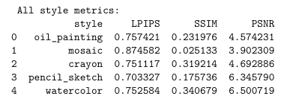
Testing and Evaluation
Metrics: LPIPS, SSIM, PSNR
Figure 1: Table of all style metrics evaluation
Notes:
We evaluated the stylized outputs both visually and using standard metrics:
LPIPS measures perceptual similarity (lower is better).
SSIM and PSNR provide structural and pixel-level comparisons. Results show successful style transfer, with the base image structure preserved and style cues applied. Some styles, like mosaic, are more visually distinct but score lower on SSIM and PSNR, reflecting the subjective nature of style transfer evaluation Here are our evaluation metrics for each style. Lower LPIPS indicates higher perceptual similarity to the original, while higher SSIM and PSNR suggest better structural and pixel-level fidelity. We observed that styles like watercolor and pencil sketch preserved more structure, while mosaic was more transformative, as reflected in the scores LPIPS (Learned Perceptual Image Patch Similarity)
SSIM (Structural Similarity Index)
PSNR (Peak Signal-to-Noise Ratio)

Slide 10
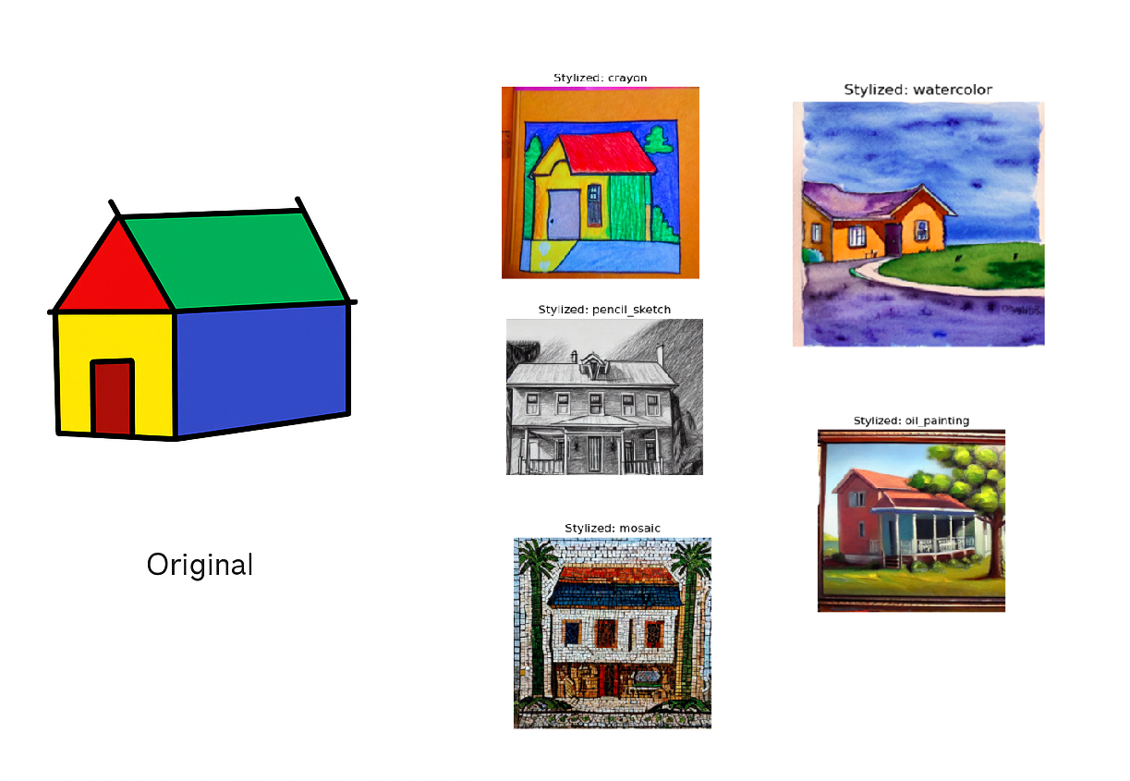
Visual Results
Figure 2: original image vs styles

Slide 11
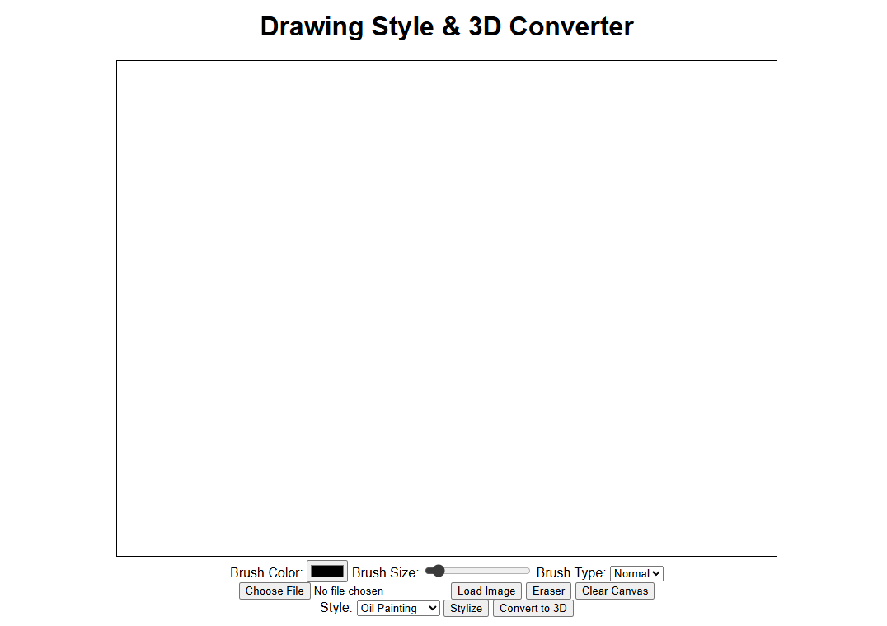
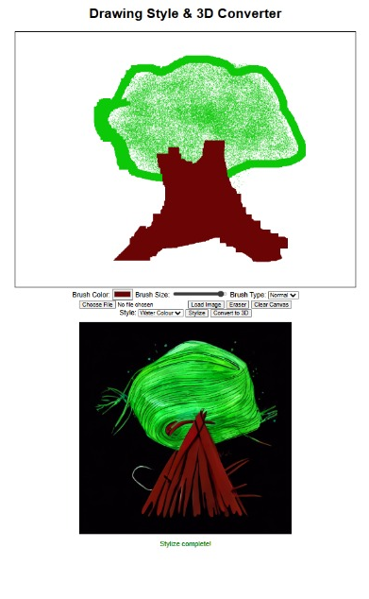
User Interface
Figure 3: UI sample output

Slide 12
Limitations & Next Steps
Limited training images → not full photorealistic.
Some style bleed due to LoRA hyperparameters.
JupyterHub environment resets → requires re-installing packages.
3D model generation has dependencies and version conflicts in three.js.
We chose to focus on functionality > perfection.
Expand dataset for better fine-tuning.
Experiment with larger LoRA ranks, more modules.
Use a better mesh refinement method for 3D.
Add user accounts to save drawings.
Notes:
While our system is functional, there’s room for improvement, especially in 3D mesh fidelity and viewer robustness. We plan to enhance mesh quality, offer direct downloads, integrate LoRA adapters into the base model for faster inference, and deploy Flask with a production server for reliability
While the system works end-to-end, mesh detail and viewer robustness can be improved. We plan to refine preprocessing, enable direct .glb downloads, and move to a production-ready Flask server for scalability.

Slide 13
Conclusion
Our project delivers a modular, real-time AI art pipeline, supporting seamless style transfer in the browser.
While current 3D mesh detail and viewer compatibility can be improved, the system is robust and extensible.
We’re well-positioned to enhance mesh quality, expand deployment, and support creative and educational uses in the future.
Notes:
In short, we’ve shown how a creative AI tool can go from user sketch to stylized art and even a basic 3D shape — all running live in a web app. We tackled training, evaluation, and deployment challenges, and learned a lot about real-world model integration.

Slide 14
References
R. Hu, X. Wang, Y. Zhang, and L. Wang, “LoRA: Low-Rank Adaptation of Large Language Models,” in Proc. International Conference on Learning Representations (ICLR), 2023. [Online]. Available: https://arxiv.org/abs/2106.09685
R. Rombach, A. Blattmann, D. Lorenz, P. Esser, and B. Ommer, “High-Resolution Image Synthesis with Latent Diffusion Models,” in Proc. IEEE/CVF Conference on Computer Vision and Pattern Recognition (CVPR), 2022, pp. 10684–10695.
Z. Zhang, J. Wang, J. Li, and H. Wang, “Hunyuan3D: 3D Shape Generation from a Single Image Using Shape Priors,” in Proc. ACM SIGGRAPH Asia, 2023. [Online]. Available: https://github.com/TencentARC/Hunyuan3D
J. Johnson, A. Alahi, and L. Fei-Fei, “Perceptual Losses for Real-Time Style Transfer and Super-Resolution,” in Proc. European Conference on Computer Vision (ECCV), 2016, pp. 694–711. (Classic reference for style transfer benchmarks; included for completeness.)
H. Wang, Y. Zhu, and X. Li, “A Survey on Text-to-Image Diffusion Models and Their Applications in Art Generation,” IEEE Transactions on Neural Networks and Learning Systems, vol. 36, no. 2, pp. 1234–1248, Feb. 2025.

Slide 15
Q&A

Slide 16
Thank You

